Slide 1

Deploying Microsoft Azure Stack Hub
Azure Stack Hub Integration
This work is licensed under a Creative Commons Attribution - ShareAlike 4.0 International Public License

Slide 2
Agenda
Introduction
Datacenter integration
IP address space
Integration with infrastructure elements

Slide 3

Cloud operating model
operate
use
Azure
Azure customers
Microsoft engineers
use
operate
Azure Stack Hub instance
Your customers
Your engineers
Cloud Architect – Design
Cloud Operator – Operate Azure Stack Hub

Slide 4
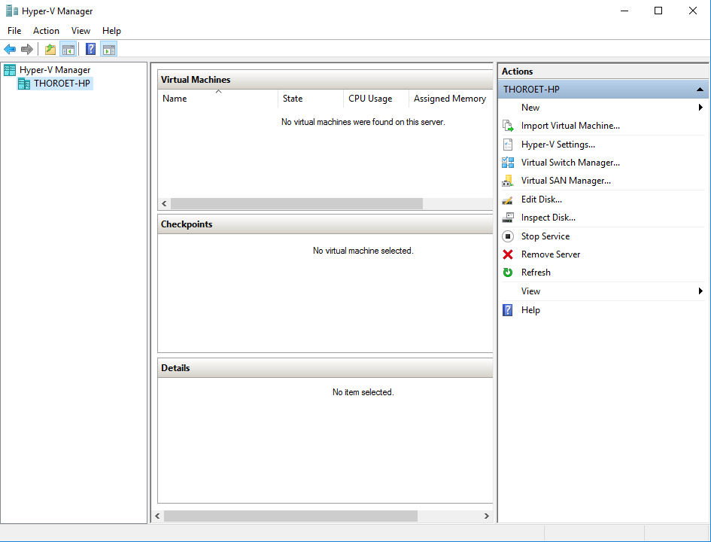
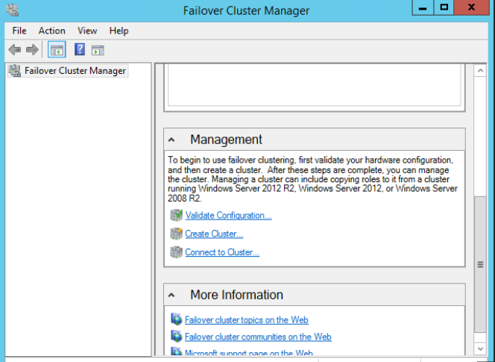
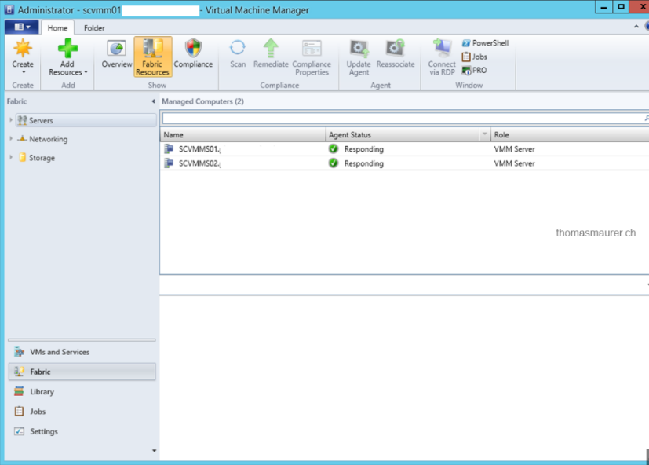
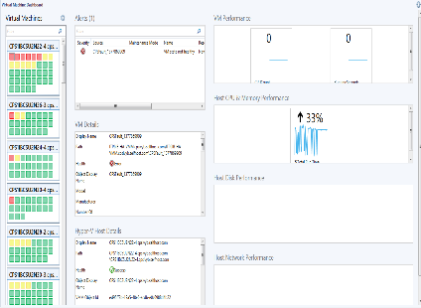
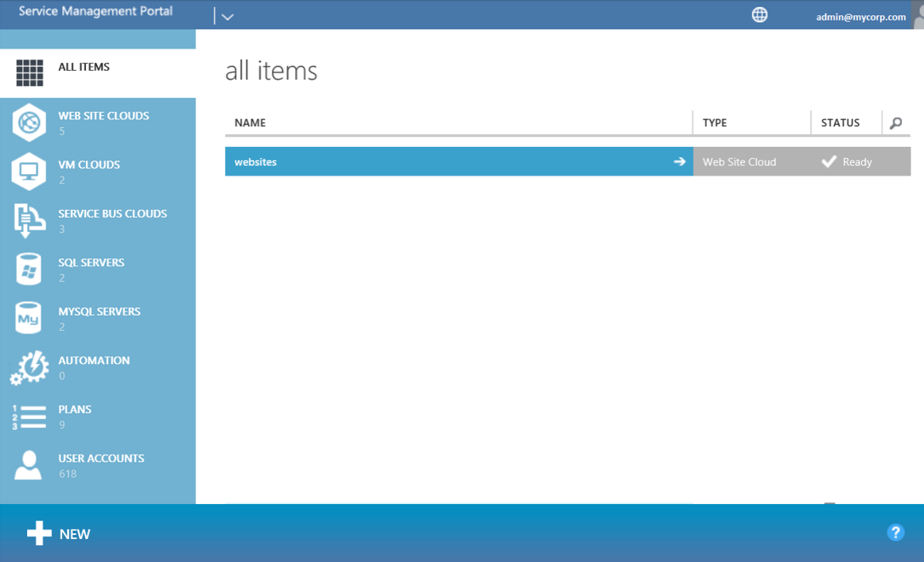
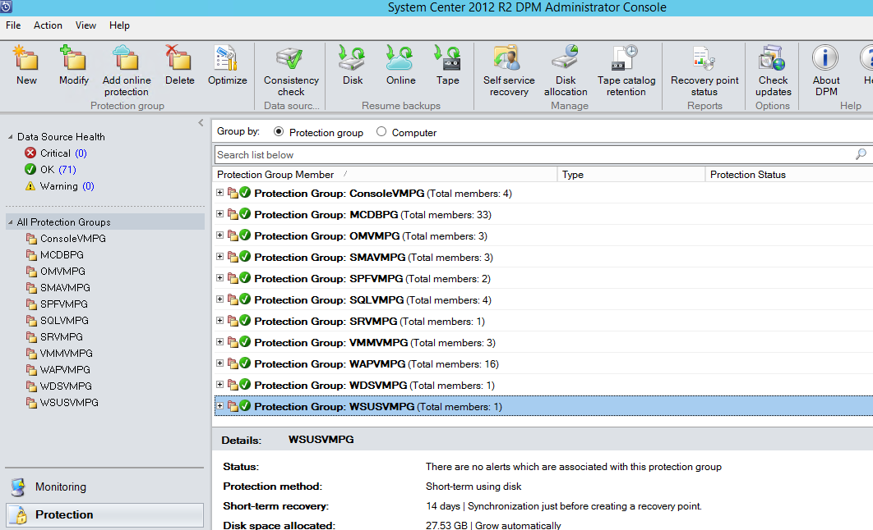
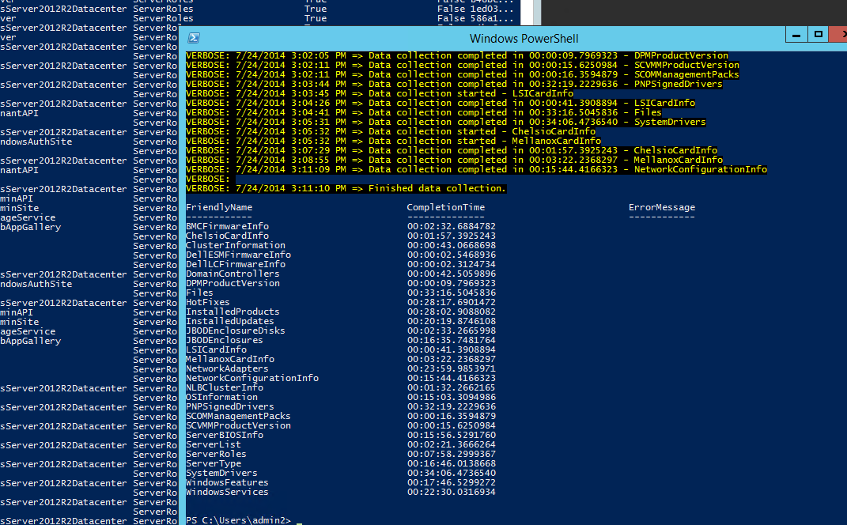
The toolbox of administrators today

Slide 5
Today’s infrastructure and cloud service mgmt.
Many silos of technology responsibility
Multiple points of infrastructure management UI and API
Deep knowledge required in each silo to operate
Not easily managed by a single administrator
Tenant Portals
Service 1
Service 2
Monitoring
Backup
Patching
Identity Mgmt
Database Mgmt
Security
Compute
Storage
Networking

Slide 6
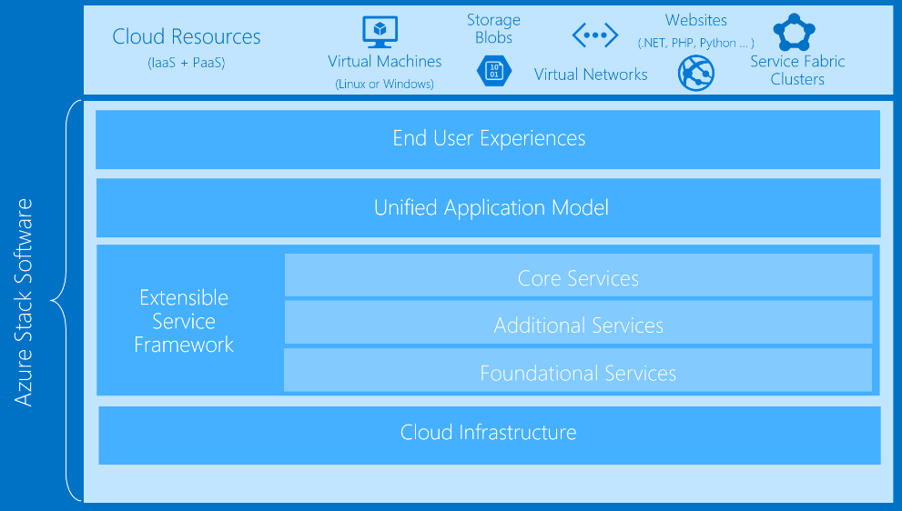
Cloud administration vision for Azure Stack Hub
Cloud Admins operate and troubleshoot across all infra
Single access point of infrastructure management UI and API
Fewer knobs to turn, deep silo knowledge not required to operate
Value to the business is Service SLA, not managing infrastructure

Slide 7
Datacenter Integration

Slide 8
Deployment and integration considerations
Identity
Tools and IDE
Monitoring
Azure Stack Hub
Networking
Billing

Slide 9
Typical datacenter integration touchpoints
IPv4
Network
Firewall
Identity
SSL
IP Space
Uplink
Publishing Rules
AAD / ADFS
SSL Certificates
DNS
NTP
Device Auth.
Syslog
ITSM /
Security
DNS
Time Server
Radius/TACAS*
Syslog Server*
ITSM Integration*

Slide 10
Revisiting the IP address space
Subnet name
Subnet size
Infrastructure
/24
Storage
/25
BMC
/27
Switch Mgmt
/25
Public VIP
/26 - /22
Advertised as individual /32s
Private VIP
/24
Advertised as individual /32s

Slide 11
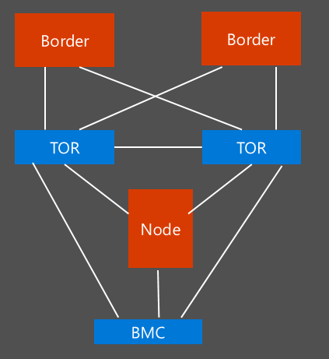
Uplink (integration with the border switches)
L3, Point-to-Point
IP subnet size /30
Routing Protocol
BGP (recommended) or Static Routing
External, infrastructure
16 Bit ASN (public or private)
New: Support different ASN per border device
Static Routing
TOR
Single static route to Border
ACL prevent certain networks to leave TOR
Border:
Static routes to P2P
ASN
ASN
L3
L3
L3
L3
Node

Slide 12
Network connectivity
Logical Networks
Logical Network | Description | Size | Routed beyond TOR
Public VIP | Public IP addresses for a small set of Azure Stack Hub services, with the rest used by tenant virtual machines. The Azure Stack Hub infrastructure uses 32 addresses from this network. If you plan to use App Service and the SQL resource providers, 7 more addresses are used. | /26 (62 hosts) - /22 (1022 hosts) Recommended = /24 (254 hosts) | Yes
Switch infrastructure | Point-to-point IP addresses for routing purposes, dedicated switch management interfaces, and loopback addresses assigned to the switch. | /26 | Yes
Infrastructure | Used for Azure Stack Hub internal components to communicate. | /24 | Yes

Slide 13
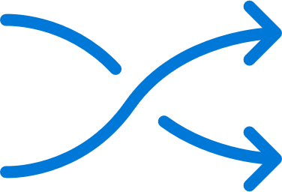



Networking integration considerations
Time Server specified at deployment but also used for Physical Network Switches:
Time across all infrastructure elements is key
Kerberos time variance (5 min)
Server nodes and fabric VMs all configured for UTC – portal exposes only correct local time to users
Supports existing logging infrastructure for:
Physical network switches
Baseboard Management Controller (BMC)
OEM Tools
Supports existing infrastructure of:
Radius with MSCHAPv2
TACACS

Slide 14
DNS services in Azure Stack Hub
Azure Stack Hub DNS namespace
Field | Description | Example
Region | The geographic location of your Azure Stack Hub deployment. | east
External Domain Name | The name of the zone you want to use for your Azure Stack Hub deployment. | cloud.fabrikam.com
Internal Domain Name | The name of the internal zone that is used for infrastructure services in Azure Stack Hub. It is Directory Service-integrated and private (not reachable from outside the Azure Stack Hub deployment). | azurestack.local
DNS Forwarder | DNS servers that are used to forward DNS queries, DNS zones and records that are hosted outside Azure Stack Hub, either on the corporate intranet or public internet. | 10.57.175.34 8.8.8.8
Naming Prefix (Optional) | The naming prefix you want your Azure Stack Hub infrastructure role instance machine names to have. If not provided, the default is azs. | azs

Slide 15
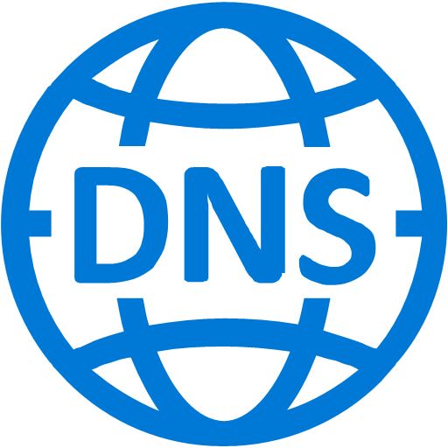
DNS services in Azure Stack Hub
External
DNS
DNS Servers: 168.63.129.16
Queries for non-authoritative zones
Delegations for AzSt zones
Authoritative
Resolver
Tenant VM
Conditional Forwarding
sea.azurestack.external → Azure Stack Hub DC
sea.azurestack.external
iDNS proxy
SoA for zone
Recursive
Resolver
Azure Stack Hub DNS
Tenant created Zone:
Contoso.com
DNS Server 1
DNS Server 2
*.azurestack.local
SoA for internal zone
Forward and reverse lookup enabled
Azure Stack Hub DC
DNS Servers: 168.63.129.16
Infra Role
Azure Stack Hub

Slide 16
DNS – Integration to resolve existing forest
Forwarding for external name resolution
Conditional forwarding to resolve corporate forest
To resolve Azure Stack Hub forest, it is a customer implementation choice
Conditional Forwarding, Delegation, Stub Zones, Root hints
Conditional Forwarding
Internal Zone
Customer Choice
Corp.local
External Zone

Slide 17
Customer corporate AD requirements
AD Graph service does the look up users for RBAC scenarios
AzS internal-AD is always pre-configured (and not exposed outside of Azure Stack Hub)
LDAP is used to connect to Corporate AD
Graph Service Requirements
The Graph service requires a service account with read-only access to the target Active Directory forest
The Graph service can only communicate with a single Active Directory Domain Services (AD DS) forest
The Graph service requires access to an AD DS global catalog server
You should create an AD site in your AD that includes the subnets where Azure Stack Hub resides. This allows Azure Stack Hub’s LDAP queries to find the closest AD global catalog server
Directory Service
AD Graph
LDAP
TCP 389/636 and 3268/3269

Slide 18
AD supported versions
Supported version of Microsoft Active Directory: 2012 / 2012 R2 / 2016
Supported Versions of AD FS: Windows Server 2012 / 2012 R2 / 2016
Single Active Directory Forest for AD Graph
Forest and Domain functional levels: Minimum 2012

Slide 19
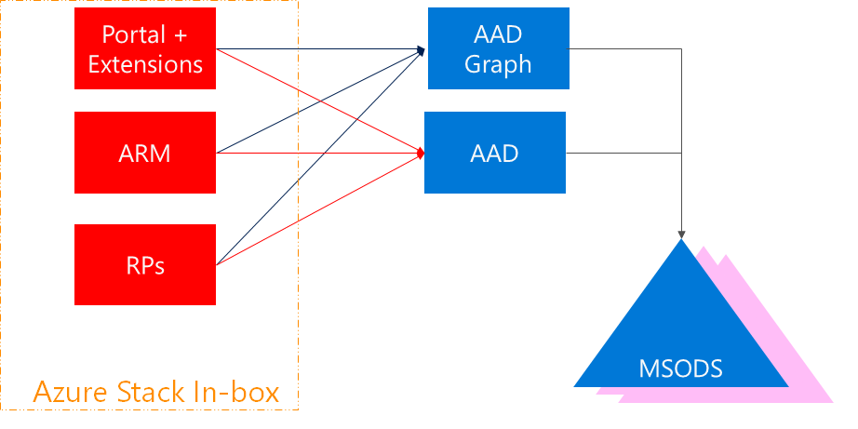
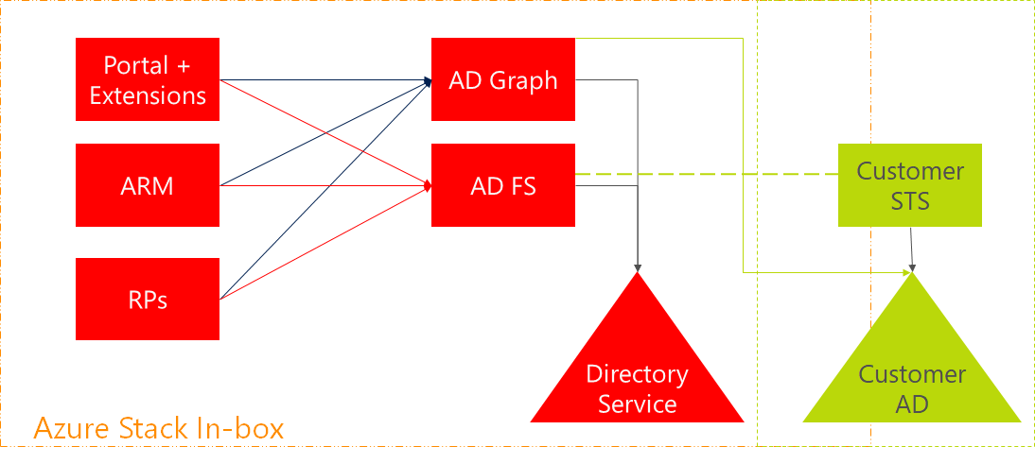
Portal authentication options
Identities from
Azure Active Directory AAD
Identities from existing
Corporate AD

Slide 20
IT Service Management integration
Enable ITSM by adopting existing pipes
Monitor with existing datacenter monitoring tooling
Use existing connections from Monitoring to Ticketing, and others
Integrated System
Azure Stack Hub Software
including storage
Physical Server
Network Devices
BMC
Rest API
IPMI
SNMP
Monitoring Solution
Hardware Lifecycle Host
Ticketing, CMDB…
Only if it is supported by OEM vendor

Slide 21

Monitoring integration solutions
Azure Stack Hub Software API
System Center Operations Manager Management Pack
Nagios Plugin
Network Devices SNMP
Operations Management Suite (OMS)
Physical Server BMC
Tenant Subscription Health Monitoring
System Center Operations Manager Hardware Vendor Management Pack
System Center Operations Manager Network Device Discovery
Hardware Vendor Nagios Plugins
OEM supported monitoring solutions on HLH
Nagios Switch Plugin
API Examples & Documentation
OEM supported monitoring solutions on HLH

Slide 22
Azure Stack Hub PKI certificate requirements
Certificate requirements
Issued by: Internal Certificate Authority or a Public Certificate Authority
Wild card: Single wild card covering all name spaces in the Subject Alternative Name (SAN) field.
Alternatively, you can use individual certificates using wild cards for endpoints such as storage and Key Vault where they are required
Signature: Cannot be SHA1, it must be stronger
File format: PFX (since both the public and private keys are needed)
Key usage: Digital Signature and Key Encipherment
PFX password: The passwords to all certificate pfx files must be the same
Subject: Ensure that the Subject Names and Subject Alternative Names of all certificates match the specifications described in this article to avoid failed deployments - https://docs.microsoft.com/en-us/azure/azure-stack/azure-stack-pki-certs

Slide 23
Azure Stack Hub PKI certificate requirements
Mandatory certificates
Deployment folder | Required certificate subject and subject alternative names (SAN) | Scope (per region) | SubDomain namespace
Public Portal | portal.<region>.<fqdn> | Portals | <region>.<fqdn>
Admin Portal | adminportal.<region>.<fqdn> | Portals | <region>.<fqdn>
Azure Resource Manager Public | management.<region>.<fqdn> | Azure Resource Manager | <region>.<fqdn>
Azure Resource Manager Admin | adminmanagement.<region>.<fqdn> | Azure Resource Manager | <region>.<fqdn>
ACSBlob | *.blob.<region>.<fqdn> | Blob Storage | blob.<region>.<fqdn>
ACSTable | *.table.<region>.<fqdn> | Table Storage | table.<region>.<fqdn>
ACSQueue | *.queue.<region>.<fqdn> | Queue Storage | queue.<region>.<fqdn>
KeyVault | *.vault.<region>.<fqdn> | Key Vault | vault.<region>.<fqdn>
KeyVaultInternal | *.adminvault.<region>.<fqdn> | Internal Keyvault | adminvault.<region>.<fqdn>

Slide 24
Azure Stack Hub PKI certificate requirements
Mandatory certificates
Deployment folder | Required certificate subject and subject alternative names (SAN) | Scope (per region) | SubDomain namespace
Admin Extension Host | *.adminhosting.<region>.<fqdn> (Wildcard SSL Certificates) | Admin Extension Host | adminhosting.<region>.<fqdn>
Public Extension Host | *.hosting.<region>.<fqdn> (Wildcard SSL Certificates) | Public Extension Host | hosting.<region>.<fqdn>

Slide 25
Azure Stack Hub PKI certificate requirements
Additional certificates for ADFS deployment
Deployment folder | Required certificate subject and subject alternative names (SAN) | Scope (per region) | SubDomain namespace
ADFS | adfs.<region>.<fqdn> (SSL Certificate) | ADFS | <region>.<fqdn>
Graph | graph.<region>.<fqdn> (SSL Certificate) | Graph | <region>.<fqdn>

Slide 26
Azure Stack Hub PKI certificate requirements
Optional PaaS certificates
Scope (per region) | Certificate | Required certificate subject and Subject Alternative Names (SANs) | SubDomain namespace
SQL, MySQL | SQL and MySQL | *.dbadapter.<region>.<fqdn> | dbadapter.<region>.<fqdn>
App Service | Web Traffic Default SSL Cert | *.appservice.<region>.<fqdn> *.scm.appservice.<region>.<fqdn> *.sso.appservice.<region>.<fqdn> (Multi Domain Wildcard SSL Certificate¹) | appservice.<region>.<fqdn> scm.appservice.<region>.<fqdn>
App Service | API | api.appservice.<region>.<fqdn> (SSL Certificate²) | appservice.<region>.<fqdn> scm.appservice.<region>.<fqdn>
App Service | FTP | ftp.appservice.<region>.<fqdn> (SSL Certificate²) | appservice.<region>.<fqdn> scm.appservice.<region>.<fqdn>
App Service | SSO | sso.appservice.<region>.<fqdn> (SSL Certificate²) | appservice.<region>.<fqdn> scm.appservice.<region>.<fqdn>
¹ Requires one certificate with multiple wildcard subject alternative names. Multiple wildcard SANs on a single certificate might not be supported by all Public Certificate Authorities
² A *.appservice.<region>.<fqdn> wild card certificate cannot be used in place of these three certificates (api.appservice.<region>.<fqdn>, ftp.appservice.<region>.<fqdn>, and sso.appservice.<region>.<fqdn>.

Slide 27
Firewall: Port requirements
Azure Stack Hub does not have a configurable setting to identify a proxy server.
You must have direct Internet access or a proxy that requires no client configuration
Customer FW
Customer Border Device
TOR & BMC (ACL Lockdown Infrastructure, Storage)
ACL
ACL
ACL
SDN
Infrastructure External
Infrastructure Internal
Tenant External
VIP
VIP
VIP
DIP
DIP
DIP
DIP
DIP
DIP

Slide 28
Accessing Azure Stack Hub Portals today
Firewall
27 Ports
Portals : 443
Azure Stack Hub
User accesing Portal
Extensions : X
User hits https://portal.region.azurestack.external
Portal does redirect to AAD/ADFS to get a Token
If successfully authenticated, redirect back to https://portal.region.azurestack.external
Portal loads extensions by pointing user’s browser to https://portal.region.azurestack.external:ExtensionPort

Slide 29
Accessing Azure Stack Hub Portals with Extension Host
4 Ports
Firewall
User Portal : 443
Azure Stack Hub
User accesing Portal
User Extension Host : 443
*.hosting.region.fqdn
Extension X : X
Increased Security
Simplified Firewall Configuration (only TCP/443 is required for access)
Enables user to access Azure Stack Hub Portal via Proxy Server which may not support ports beyond 80 and 443
Faster adoption of new Azure services

Slide 30
Edge deployment
Firewall is a recommended way to protect the Azure Stack Hub
Azure Stack Hub uses ACLs for the VIPs and Physical Switches
This shows how Azure Stack Hub is connected to an existing edge firewall
Agg / Edge Router
Firewall
ToR
BMC
ToR
Private
Storage & Infra VIPs
(10.11.128.0/24)
Private
Infrastructure Services
(10.11.130.0/24)
Service VIPs
Tenant VIPs
Public VIPs (65.53.123.0/22)
Azure Stack Hub
Firewall/NAT/Proxy
Intranet Networks

Slide 31
Enterprise/intranet/DMZ
Traditional enterprise deployment with DMZ between internal network and Internet
Options for connecting Azure Stack Hub to the DMZ are through firewall, NAT, and reverse proxy
Agg / Edge Router
Firewall
DMZ
Firewall/NAT/Proxy
ToR
BMC
ToR
Private
Storage & Infra VIPs
(10.11.128.0/24)
Private
Infrastructure Services
(10.11.130.0/24)
Service VIPs
Tenant VIPs
Public VIPs (65.53.123.0/22)
Azure Stack Hub

Slide 32
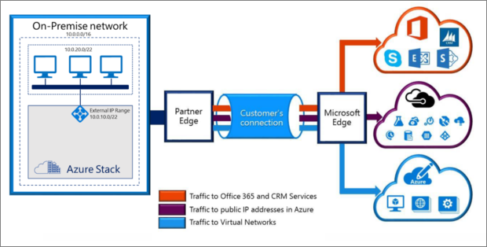
ExpressRoute for single tenant

Slide 33
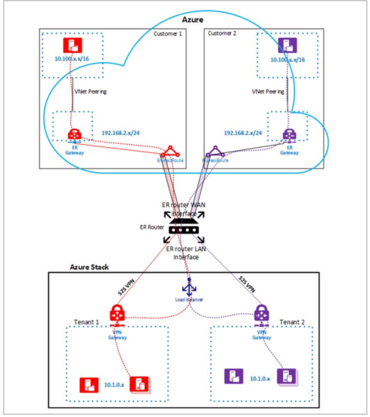
ExpressRoute for multi-tenant scenario
Each tenant create S2S VPN connection between Azure Stack Hub VNet and ER router
VNet’s from Azure are connected to ER router
The ER router LAN interface needs one IP address per Azure Stack Hub vnet
https://docs.microsoft.com/en-us/azure/azure-stack/azure-stack-connect-expressroute

Slide 34

Security log integration
What logs are collected?
Windows System, Application, and Security Event logs
Active Directory Application and Diagnostic Logs
DNS Application and Diagnostic Logs
Other security-related events
How are they collected?
Azure Monitoring Agent
Where are they stored?
FRP – Storage Account (General Windows Event logs_)
Component Storage Account
How can I access the logs?
Storage Explorer (TP3)

Slide 35
Questions?

Slide 37
Appendix

Slide 38
Required firewall ports
Endpoint (VIP) | DNS host A record | Protocol | Ports
AD FS | Adfs.<region>.<fqdn> | HTTPS | 443
Portal (administrator) | Adminportal.<region>.<fqdn> | HTTPS | 443 12495 12499 12646 12647 12648 12649 12650 13001 13003 13010 13011 13020 13021 13026 30015

Slide 39
Required firewall ports
Endpoint (VIP) | DNS host A record | Protocol | Ports
Azure Resource Manager (administrator) | Adminmanagement.<region>.<fqdn> | HTTPS | 443 30024
Portal (user) | Portal.<region>.<fqdn> | HTTPS | 443 12495 12649 13001 13010 13011 13020 13021 30015 13003
Azure Resource Manager (user) | Management.<region>.<fqdn> | HTTPS | 443 30024
Graph | Graph.<region>.<fqdn> | HTTPS | 443
Certificate revocation list | Crl.<region>.<fqdn> | HTTP | 80
DNS | *.<region>.<fqdn> | TCP & UDP | 53

Slide 40
Required firewall ports
Endpoint (VIP) | DNS host A record | Protocol | Ports
Key Vault (user) | *.vault.<region>.<fqdn> | HTTPS | 443
Key Vault (administrator) | *.adminvault.<region>.<fqdn> | HTTPS | 443
Storage Queue | *.queue.<region>.<fqdn> | HTTP HTTPS | 80 443
Storage Table | *.table.<region>.<fqdn> | HTTP HTTPS | 80 443
Storage Blob | *.blob.<region>.<fqdn> | HTTP HTTPS | 80 443
SQL Resource Provider | sqladapter.dbadapter.<region>.<fqdn> | HTTPS | 44300-44304
MySQL Resource Provider | mysqladapter.dbadapter.<region>.<fqdn> | HTTPS | 44300-44304

